Slide 1
Probability / Severity Model

Slide 2
Zero Inflated Target

Slide 3
Zero Inflated Target
DEFINITION:
Continuous target with a high frequency of records at zero.
Data that is not zero, is distributed around some larger value.
EXAMPLE
CAR CRASH
Most people do NOT crash their cars, so insurance claims are usually zero.
However, if you DO crash your car, your damage will be large (say $5000).
LOAN DEFAULT
Most people do NOT default on loans, so losses are usually zero.
However, if you DO default on a loan, your default will be large (say $100,000)
AIR TRAVEL
Most people do NOT fly on airplanes every year, so miles travelled are zero
However, if you DO fly on an airplane, you will usually travel at least 500 miles.

Slide 4
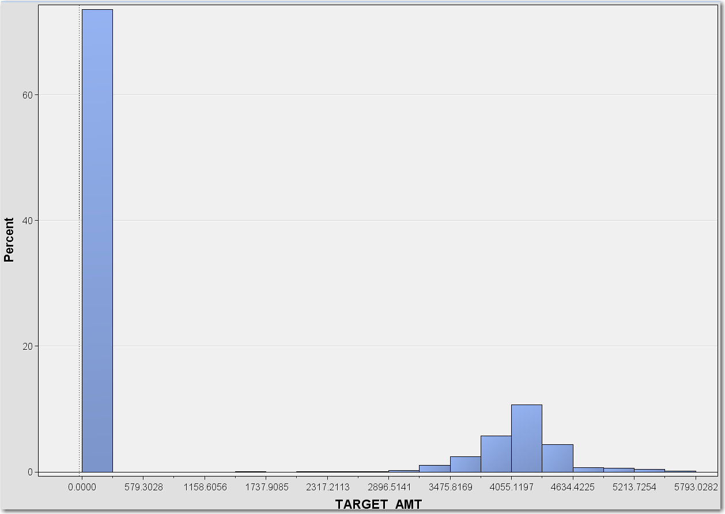
Zero Inflated Target
GRAPH OF ZERO INFLATED DATA
Assume that the data below represents car crash data
Notice that ~ 70% of the records are zero
The customers that were in a crash have a normally distributed loss averaging $5000

Slide 5
Modeling Zero Inflated Target
TRADITIONAL APPROACHES
Use Standard techniques such as linear regression.
Advantage
Simple approach, easily understood
Could possibly give good results. Always worth a try.
Disadvantages
Violates assumptions of Linear Regression and could lead to poor accuracy.

Slide 6
Modeling Zero Inflated Target
EXOTIC APPROACHES SUCH AS MODELING “TWEEDIE DISTRIBUTION”
There is an entire branch of analytics devoted to this type of problem, this type of problem is known as a “Tweedie Distribution” problem.
Note: (Tweedie Distribution is beyond the scope of this class)
Advantage
Software is available that is specifically designed for this type of problem.
Disadvantages
Mathematically intense, not everybody has the skill set for this approach.
No guarantee it will be better than a simple approach.
Just because it’s complicated, doesn’t mean it’s correct

Slide 7
Modeling Zero Inflated Target
PROBABILITY / SEVERITY MODEL
Break complicated problem into two smaller problems. For example, CAR CRASH:
What is the probability that a person will crash their car?
If a person crashes their car, what will it cost?
Advantage
Logistic and Linear regression are simple and well understood
Can give good results
Disadvantages
Build two models instead of one, and both need to be accurate
Requires coding skill to separate the data and then combine the results

Slide 8
Probability / Severity
EXAMPLE: Predict Expected Losses for Auto Insurer
STEP 1: PROBABILITY MODEL
Use ALL the data to develop a LOGISTIC regression model to predict probability that a customer will crash their car
STEP 2: SEVERITY MODEL
Subset the data to create a data set made up of ONLY people who had crashes
Build a LINEAR regression model to predict the amount of damages assuming that the customer does crash their car
STEP 3: EXPECTED LOSSES
Multiply PROBABILITY by SEVERITY to arrive at expected losses

Slide 9
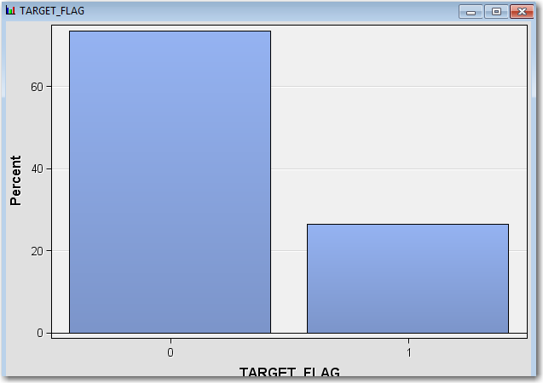
Probability / Severity : STEP 1
STEP 1: PROBABILITY MODEL … MODEL TRAINING CODE
For demonstration purposes an overly simplified model was developed to predict the PROBABILITY that a person will crash their car. The model has only one predictive variable, MVR_PTS (the number of traffic tickets on their driving record).

Slide 10
Probability / Severity : STEP 1
STEP 1: PROBABILITY MODEL … MODEL TRAINING CODE
The following code will determine the probability that a person will be in a car crash:
%let INFILE = &LIB.INSURANCE_PROB_SEV;
proc logistic data=&INFILE.;
model TARGET_FLAG(ref=“0”) = MVR_PTS;
run;

Slide 11
Probability / Severity : STEP 1
STEP 1: PROBABILITY MODEL … LOGISTIC FORMULA
Using only this variable, the following logistic regression formula was calculated:
LOG_ODDS = -1.4345 + 0.2151*MVR_PTS
The scoring program for this formula is given as:

Slide 12
Probability / Severity : STEP 1
STEP 1: PROBABILITY MODEL … SCORE CODE
%let INFILE = &LIB.INSURANCE_PROB_SEV;
%let OUTFILE = OUTFILE_FLAG;
%macro SCORE_FLAG( INFILE, OUTFILE );
data &OUTFILE.;
set &INFILE.;
LOG_ODDS = -1.4345 + 0.2151*MVR_PTS;
ODDS = exp( LOG_ODDS );
P_TARGET_FLAG = ODDS / (1+ODDS);
drop LOG_ODDS ODDS;
run;
%mend;
%score_flag( &INFILE. , &OUTFILE. );
proc print data=&OUTFILE.(obs=10);
var INDEX TARGET_FLAG MVR_PTS P_TARGET_FLAG;
run;

Slide 13
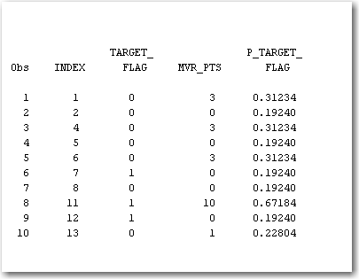
Probability / Severity : STEP 1
STEP 1: PROBABILITY MODEL … OUTPUT

Slide 14
Probability / Severity : STEP 2
STEP 2: SEVERITY MODEL … MODEL TRAINING CODE
For demonstration purposes an overly simplified model was developed to predict the SEVERITY of an accident, assuming that a person has an accident. The model has only one predictive variable, BLUEBOOK (the estimated value of a person’s car).
There is one catch to this model, before doing the PROC REG, the data set must be pruned so that it only includes records where a person had a car crash.

Slide 15
Probability / Severity : STEP 2
STEP 2: SEVERITY MODEL … MODEL TRAINING CODE
The following code will have only records where a person had a car crash:
%let INFILE = &LIB.INSURANCE_PROB_SEV;
data TEMPFILE;
set &INFILE.;
if TARGET_AMT > 0;
run;
proc reg data=TEMPFILE;
model TARGET_AMT = BLUEBOOK;
run;
quit;

Slide 16
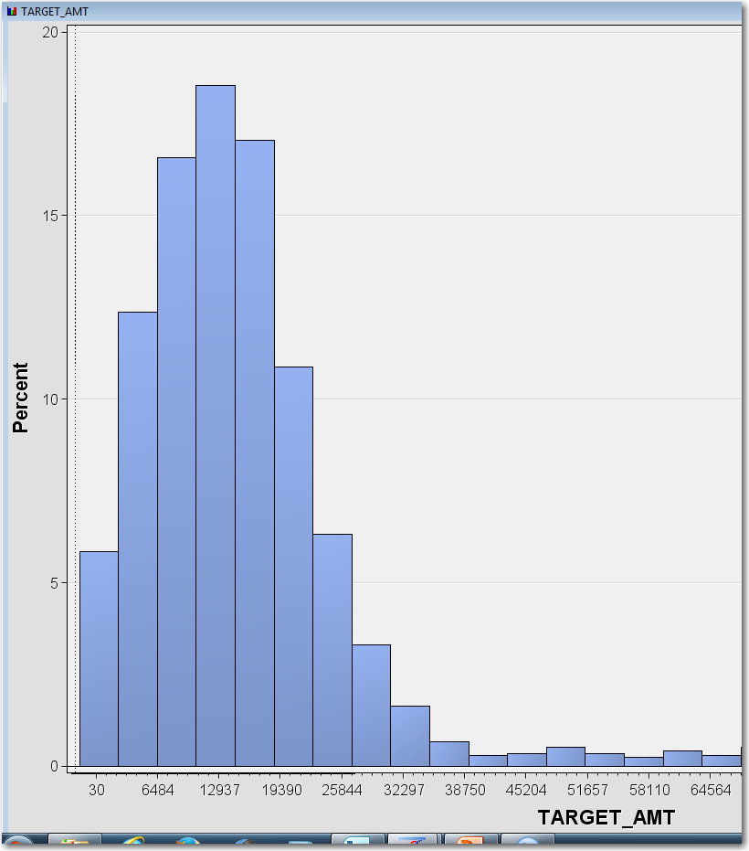
Probability / Severity : STEP 2
STEP 2: SEVERITY MODEL … MODEL TRAINING CODE
This is the distribution after the “NonCrash” customers were removed from the data.

Slide 17
Probability / Severity : STEP 2
STEP 2: SEVERITY MODEL … LINEAR REGRESSION FORMULA
Using only this variable, the following linear regression formula was calculated:
P_TARGET_AMT = 4131.65 + 0.11017*BLUEBOOK
The scoring program for this formula is given as:

Slide 18
Probability / Severity : STEP 2
STEP 2: SEVERITY MODEL … SCORE CODE
%let INFILE = &LIB.INSURANCE_PROB_SEV;
%let OUTFILE = OUTFILE_FLAG;
%macro SCORE_AMT( INFILE, OUTFILE );
data &OUTFILE.;
set &INFILE.;
P_TARGET_AMT = 4131.65 + 0.11017 * BLUEBOOK;
run;
%mend;
%score_amt( &INFILE. , &OUTFILE. );
proc print data=&OUTFILE.(obs=10);
var INDEX TARGET_AMT BLUEBOOK P_TARGET_AMT;
run;

Slide 19
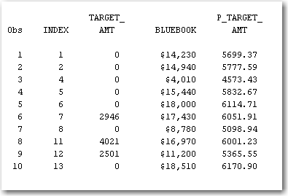
Probability / Severity : STEP 2
STEP 2: SEVERITY MODEL … OUTPUT

Slide 20
Probability / Severity : STEP 3
STEP 3: EXPECTED LOSSES … MODEL TRAINING CODE
The expected losses of a customer are simply the PREDICTED PROBABILITY of a crash multiplied by PREDICTED LOSS if there is a crash.
P_TARGET = P_TARGET_FLAG * P_TARGET_AMT

Slide 21
Probability / Severity : STEP 3
STEP 3: EXPECTED LOSSES … SCORE CODE (page 1 of 2)
%let INFILE = &LIB.INSURANCE_PROB_SEV;
%let OUTFILE = OUTFILE_FLAG;
%macro SCORE_FLAG( INFILE, OUTFILE );
data &OUTFILE.;
set &INFILE.;
LOG_ODDS = -1.4345 + 0.2151*MVR_PTS;
ODDS = exp( LOG_ODDS );
P_TARGET_FLAG = ODDS / (1+ODDS);
drop LOG_ODDS ODDS;
run;
%mend;

Slide 22
Probability / Severity : STEP 3
STEP 3: EXPECTED LOSSES … SCORE CODE (page 2 of 2)
%macro SCORE_AMT( INFILE, OUTFILE );
data &OUTFILE.;
set &INFILE.;
P_TARGET_AMT = 4131.65 + 0.11017 * BLUEBOOK;
run;
%mend;
%score_flag( &INFILE. , &OUTFILE. );
%score_amt( &OUTFILE. , &OUTFILE. );
data &OUTFILE.;
set &OUTFILE.;
P_TARGET = P_TARGET_FLAG * P_TARGET_AMT;
run;
proc print data=&OUTFILE.(obs=10);
run;

Slide 23
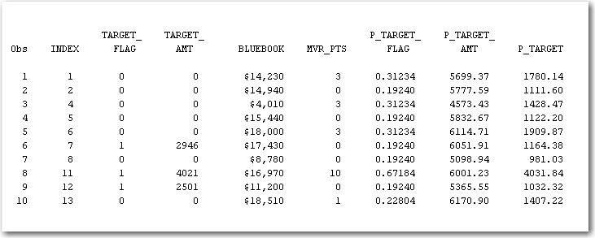
Probability / Severity : STEP 3
STEP 3: EXPECTED LOSSES … OUTPUT

